Slide 1
BUSI4496
Supply Chain Planning & Management
Inventory Management Seminar- problems and solutions
Dr Nahid Yazdani

Slide 2
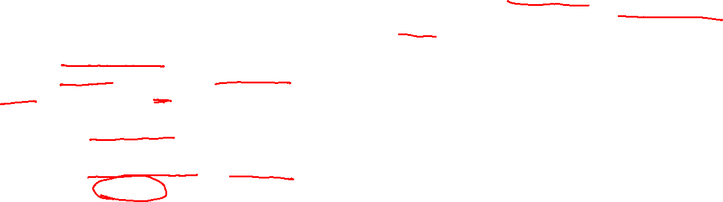
Problem 1
Determine the optimal size of the orders of hex nuts and molly screws, and the optimal time between placements of orders of these two items.
If both items are ordered and received simultaneously, the setup cost of $100 applies to the combined order. Compare the average annual cost of holding and setup if these items are ordered separately; if they are both ordered when the hex nuts would normally be ordered; and if they are both ordered when the molly screws would normally be ordered.
A local machine shop buys hex nuts and molly screws from the same supplier. The hex nuts cost 15 cents each and the molly screws cost 38 cents each. A setup cost of $100 is assumed for all the orders. This includes the cost of tracking and receiving the orders. Holding costs are based on a 25% annual interest rate. The shop uses an average of 20,000 hex nuts and 14,000 molly screws annually.

Slide 3
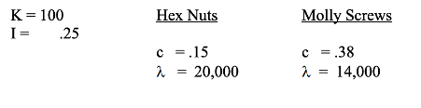


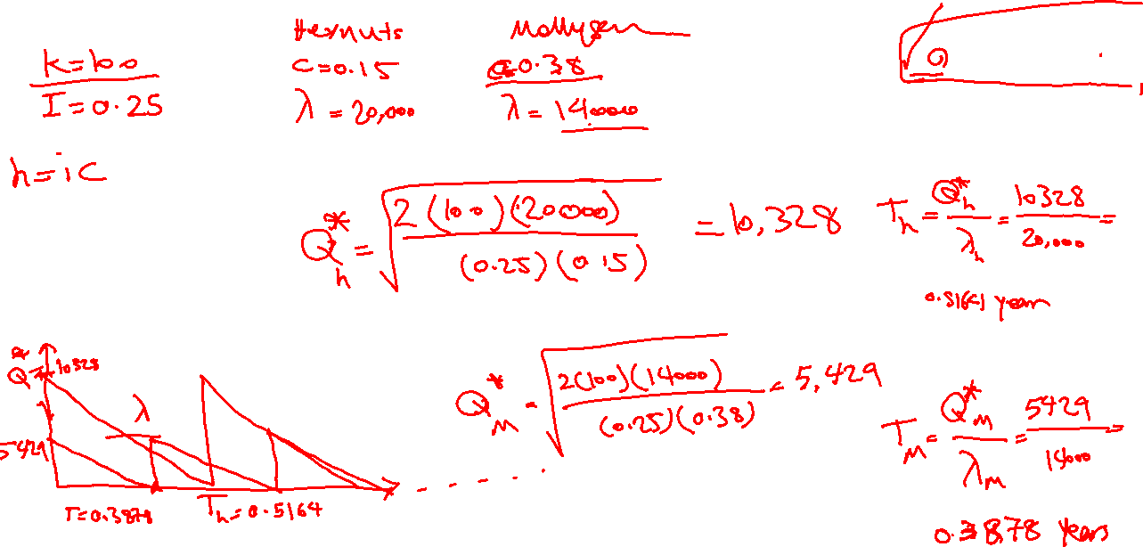
(1 a) Determine the optimal size of the orders of hex nuts and molly screws, and the optimal time between placements of orders of these two items.
$$Q^{∗}= EOQ = {\left(\frac{2K\text{l}}{h}\right)}^{\frac{1}{2}}$$
$T =\frac{Q}{λ}$

Slide 4
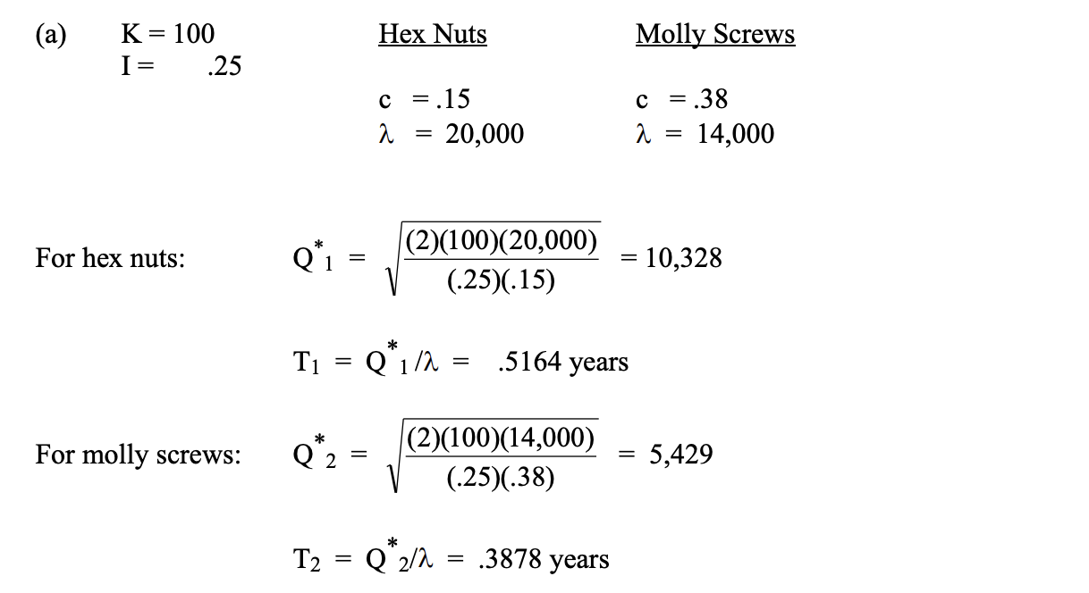
(1 a) Determine the optimal size of the orders of hex nuts and molly screws, and the optimal time between placements of orders of these two items.
Problem & Solution

Slide 5
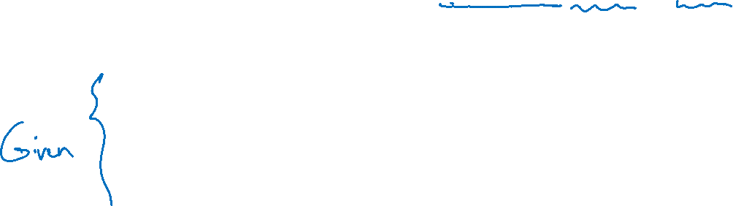




(1b) If both items are ordered and received simultaneously, the setup cost of $100 applies to the combined order. Compare the average annual cost of holding and setup if these items are ordered separately; if they are both ordered when the hex nuts would normally be ordered; and if they are both ordered when the molly screws would normally be ordered.
𝑮(𝑸∗) = $\sqrt{\text{2}\text{K}\text{λ}\text{h}}$
holding cost= $½hQ$
$T =\frac{Q}{λ}$
$$Q=λT$$

Slide 6
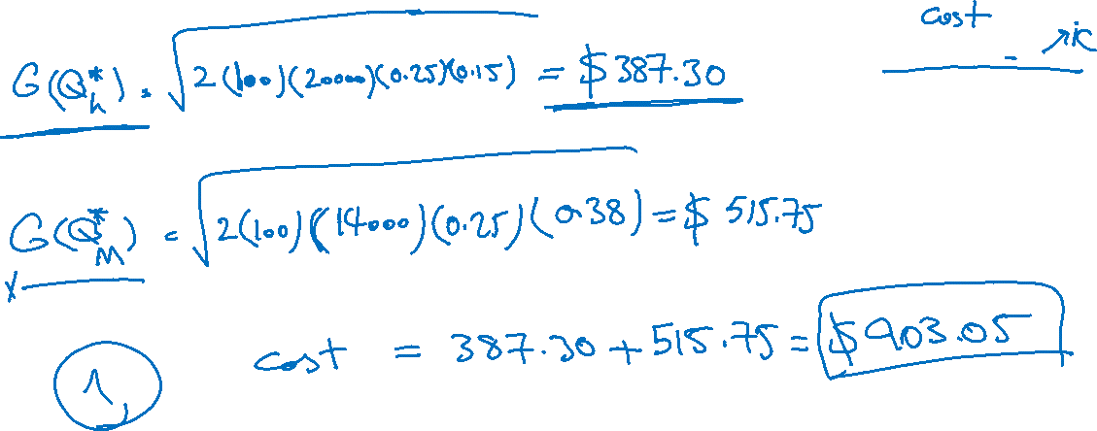
(1b) If both items are ordered and received simultaneously, the setup cost of $100 applies to the combined order. Compare the average annual cost of holding and setup if these items are ordered separately; if they are both ordered when the hex nuts would normally be ordered; and if they are both ordered when the molly screws would normally be ordered.
𝑮(𝑸∗) = $\sqrt{\text{2}\text{K}\text{λ}\text{h}}$
holding cost= $½hQ$
$T =\frac{Q}{λ}$
$$Q=λT$$

Slide 7
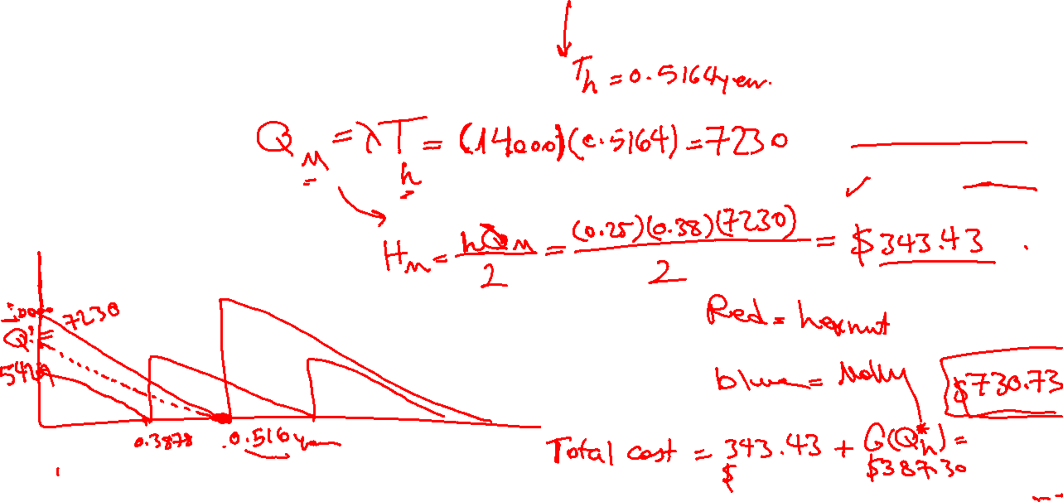
(1b) If both items are ordered and received simultaneously, the setup cost of $100 applies to the combined order. Compare the average annual cost of holding and setup if these items are ordered separately; if they are both ordered when the hex nuts would normally be ordered; and if they are both ordered when the molly screws would normally be ordered.
𝑮(𝑸∗) = $\sqrt{\text{2}\text{K}\text{λ}\text{h}}$
holding cost= $½hQ$
$T =\frac{Q}{λ}$
$$Q=λT$$

Slide 8
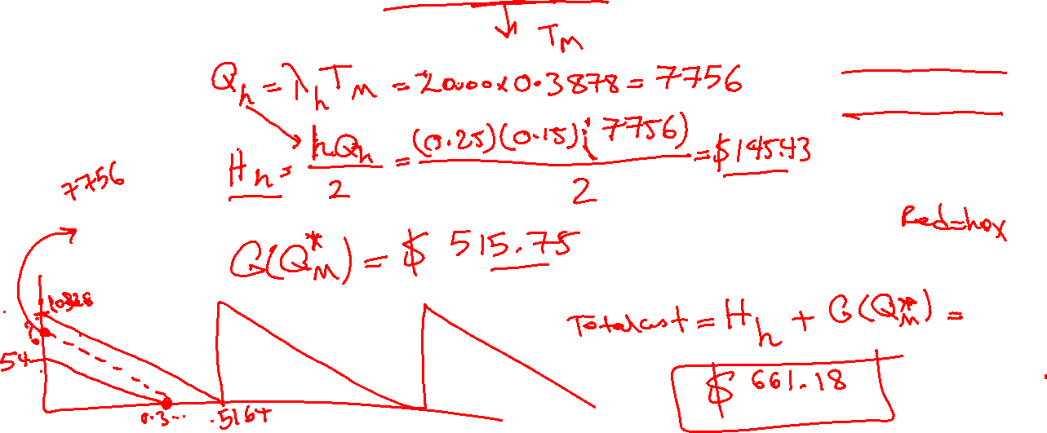
(1b) If both items are ordered and received simultaneously, the setup cost of $100 applies to the combined order. Compare the average annual cost of holding and setup if these items are ordered separately; if they are both ordered when the hex nuts would normally be ordered; and if they are both ordered when the molly screws would normally be ordered.
𝑮(𝑸∗) = $\sqrt{\text{2}\text{K}\text{λ}\text{h}}$
holding cost= $½hQ$
$T =\frac{Q}{λ}$
$$Q=λT$$

Slide 9
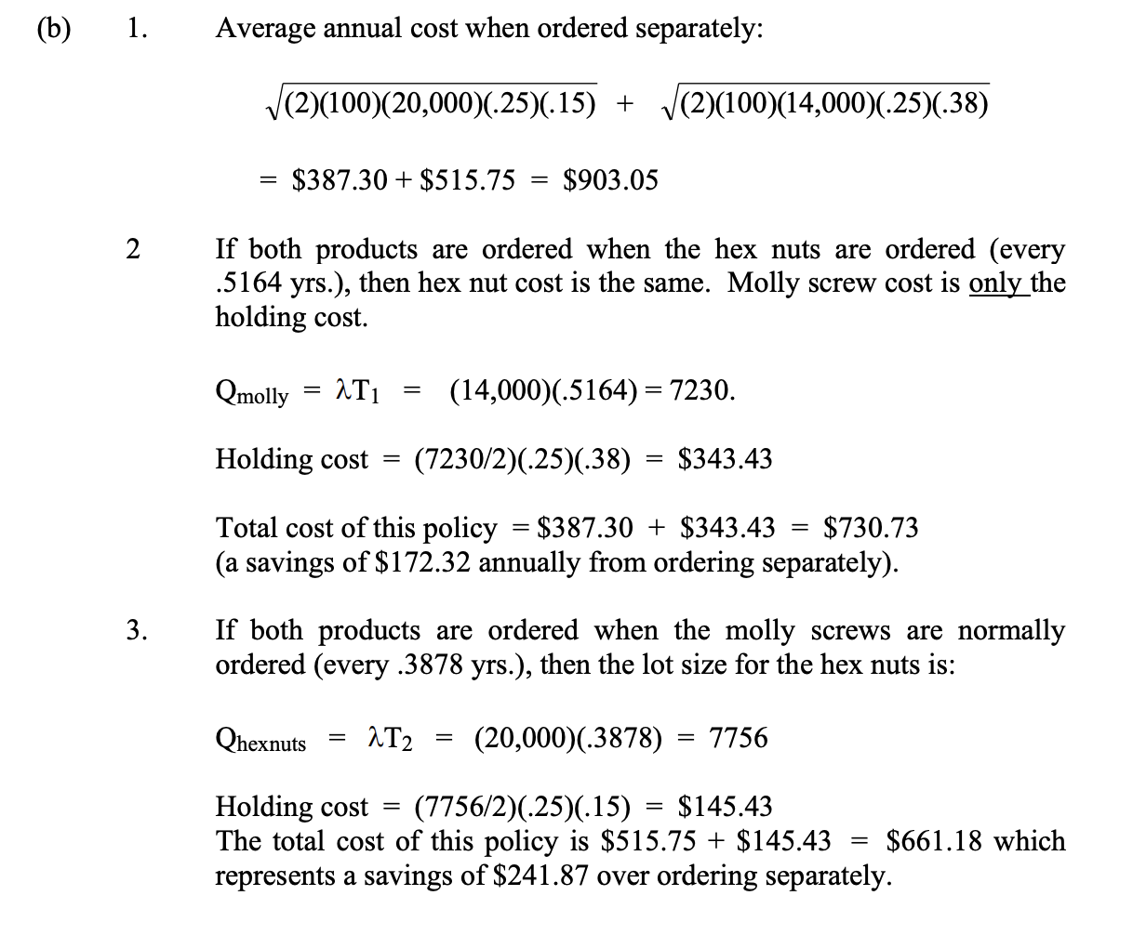
(1b) If both items are ordered and received simultaneously, the setup cost of $100 applies to the combined order.
Compare the average annual cost of holding and setup:
if these items are ordered separately;
if they are both ordered when the hex nuts would normally be ordered;
and if they are both ordered when the molly screws would normally be ordered.
Problem & Solution

Slide 10
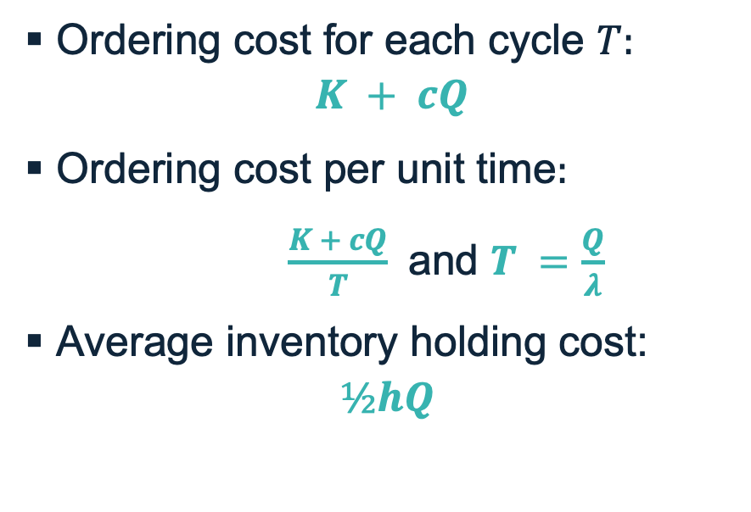
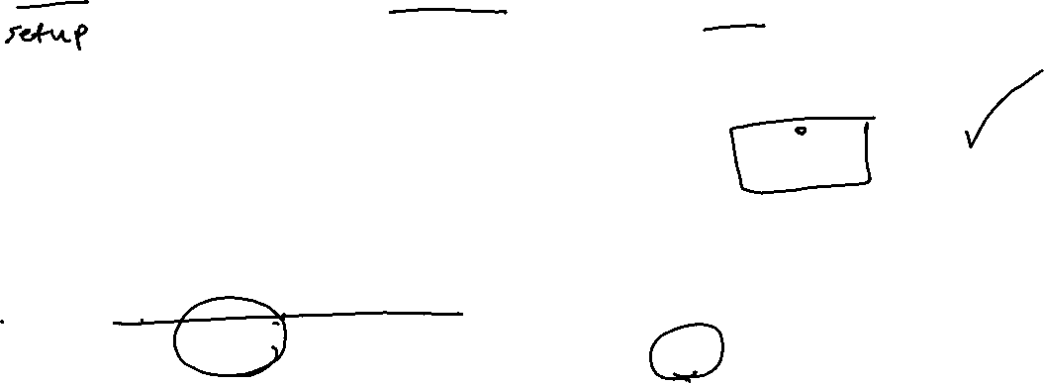
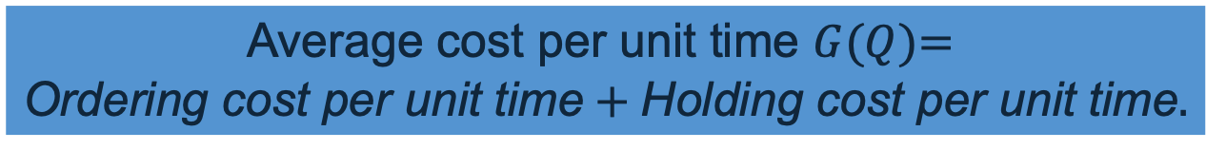
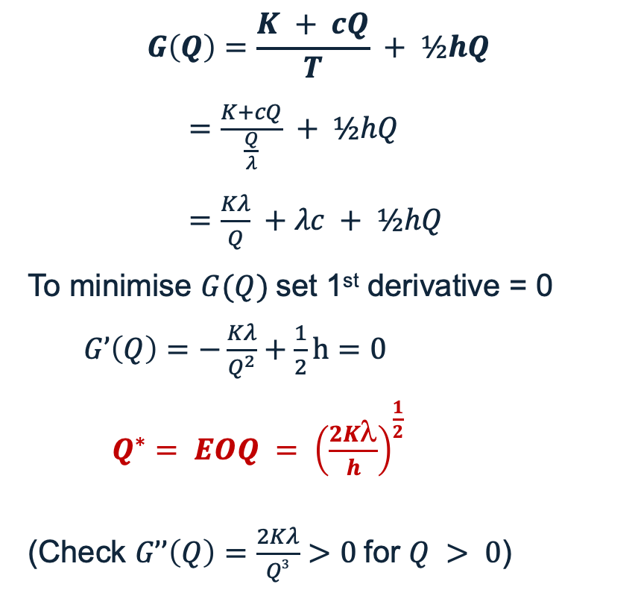
EOQ
$$\text{Average} \text{cost} \text{per} \text{unit} \text{time} G(Q)\text{= }$$
$$\text{Ordering} \text{cost} \text{per} \text{unit} \text{time}+\text{Holding} \text{cost} \text{per} \text{unit} \text{time}.$$
$$G\left(Q\right)=\frac{K + cQ}{T} + ½hQ$$
$=\frac{K+cQ}{\frac{Q}{λ}} + ½hQ$
$=\frac{Kλ}{Q} +λc + ½hQ$
To minimise $G(Q)$set 1st derivative = 0
  $G’\left(Q\right)=−\frac{Kλ}{Q^{2}}+\frac{1}{2}h=0$
$Q^{∗}= EOQ = {\left(\frac{2K\text{l}}{h}\right)}^{\frac{1}{2}}$
(Check $G’’\left(Q\right)=\frac{2Kλ}{Q3}>0$for $Q > 0$)
Ordering cost for each cycle $T:$
$$K + cQ$$
Ordering cost per unit time$:$
$\frac{K + cQ}{T}$ and $T =\frac{Q}{λ}$
Average inventory holding cost:
$$½hQ$$

Slide 11

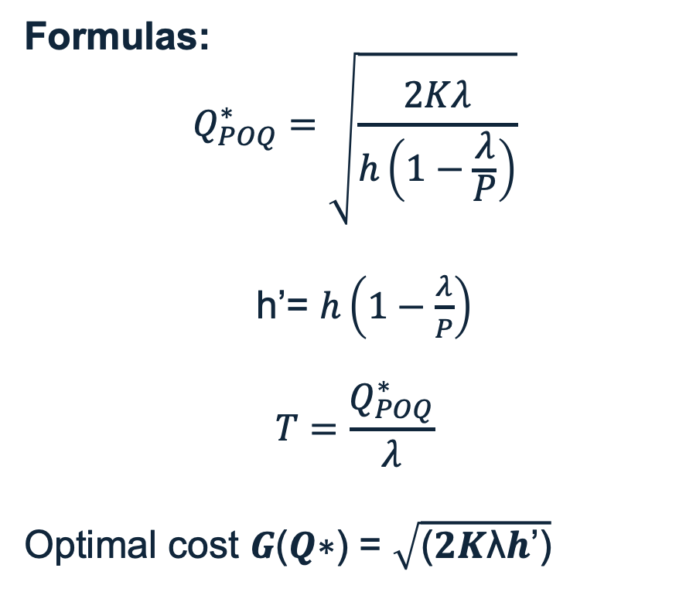

Important Reminder
In some inventory problems, you may be asked to compare the cost of purchasing an item with the cost of producing it yourself.
In these situations, you will also need to use the POQ model.
When using POQ:
The ordering cost (K) from EOQ is replaced by a setup cost (K).
The holding cost h is adjusted to h’ (because production occurs gradually, not all at once).
The logic of the calculations remains similar to EOQ, but the formulas differ to reflect the production rate.
Formulas:
$$Q_{POQ}^{∗}=\sqrt{\frac{2Kλ}{h\left(1−\frac{λ}{P}\right)}}$$
h’= $h\left(1−\frac{λ}{P}\right)$
$$T=\frac{Q_{POQ}^{∗}}{λ}$$
Optimal cost 𝑮(𝑸∗) = $\sqrt{\text{(}\text{2}\text{K}\text{λ}\text{h}\text{’}\text{)}}$

Slide 12
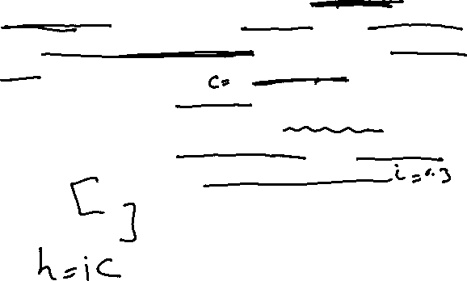
Problem 2
(2a) Calculate Q and R using a managerial approach so that there is no stock-out in 90% of the order cycles.
(2b) What is the safety stock for this paint?
(2c) Suppose that, unfortunately, he really wanted to satisfy 90% of his demands (that is, achieve a 90% fill rate). What fill rate did he actually achieve from the policy determined in (2a).
Weiss’s paint store uses a (Q, R) inventory system to control its stock levels. For a particularly popular white latex paint, historical data show that the distribution of monthly demand is approximately normal, with mean 28 and standard deviation 8. Replenishment lead time for this paint is about 14 weeks. Each can of paint costs the store $6. Assume that excess demands are back-ordered. Fixed costs of replenishment are $15 per order and holding costs are based on a 30% annual rate of interest. (Assume 4 weeks/month and 48 weeks/year.)

Slide 13
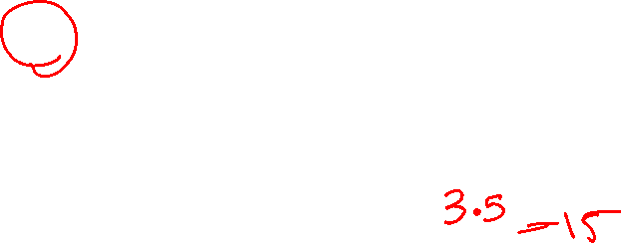
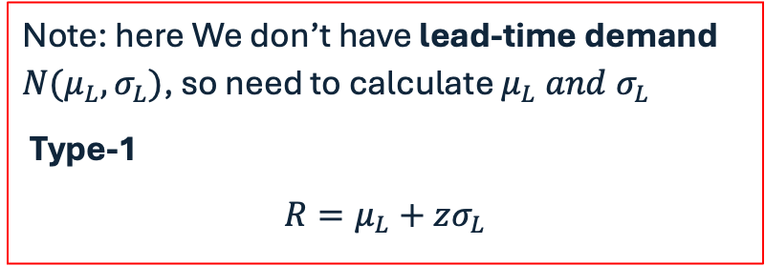
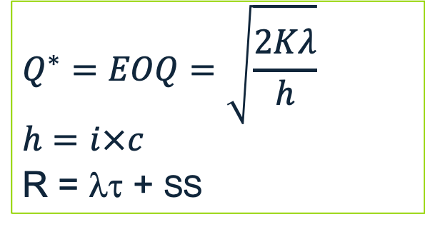
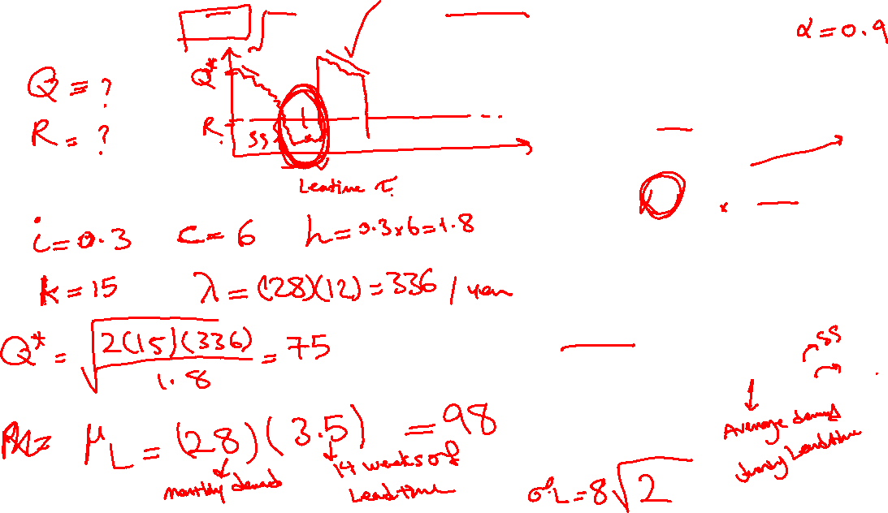

(2a) Calculate Q and R using a managerial approach so that there is no stock-out in 90% of the order cycles.
$$Q^{∗}=EOQ=\sqrt{\frac{2Kλ}{h}}$$
$$h=i×c$$
R = λτ + SS
Note: here We don’t have lead-time demand $N(μ_{L},σ_{L})$, so need to calculate $μ_{L} and{ σ}_{L}$
Type-1
$$R=μ_{L}+zσ_{L}$$
σ_{L​}=σ​​$\sqrt{\text{t}}$

Slide 14

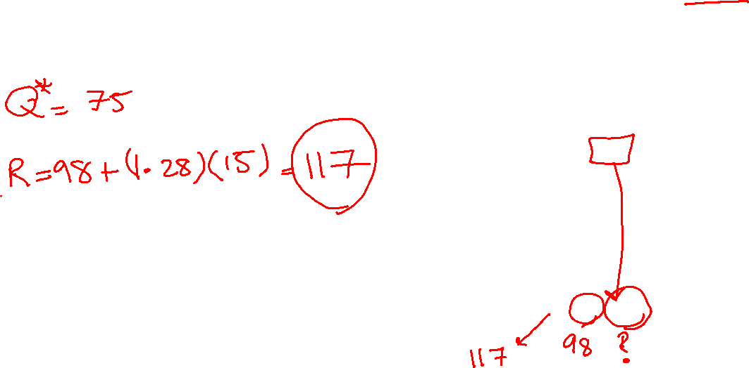
(2a) Calculate Q and R using a managerial approach so that there is no stock-out in 90% of the order cycles.
$$Q^{∗}=EOQ=\sqrt{\frac{2Kλ}{h}}$$
$$h=i×c$$
R = λτ + SS
Note: here We don’t have lead-time demand $N(μ_{L},σ_{L})$, so need to calculate $μ_{L} and{ σ}_{L}$
Type-1
$$R=μ_{L}+zσ_{L}$$
σ_{L​}=σ​​$\sqrt{\text{t}}$

Slide 15
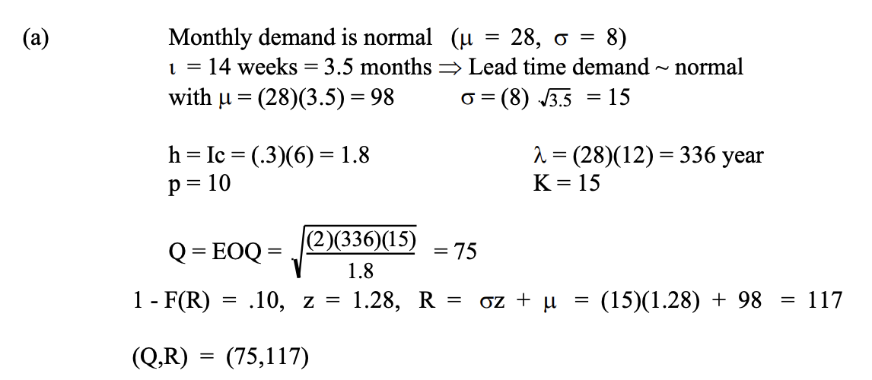

(2a) Calculate Q and R using a managerial approach so that there is no stock-out in 90% of the order cycles.
Problem & Solution

Slide 16

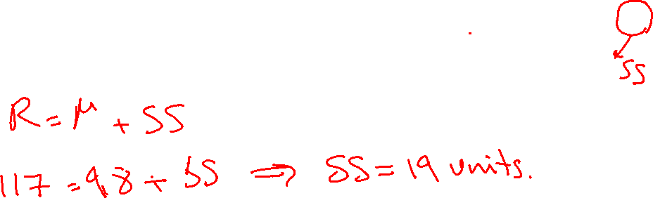
(2b) What is the safety stock for this paint?
R = λτ + SS = $μ_{L}+zσ_{L}$

Slide 17
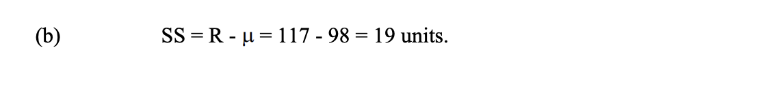
(2b) What is the safety stock for this paint?
Problem & Solution

Slide 18
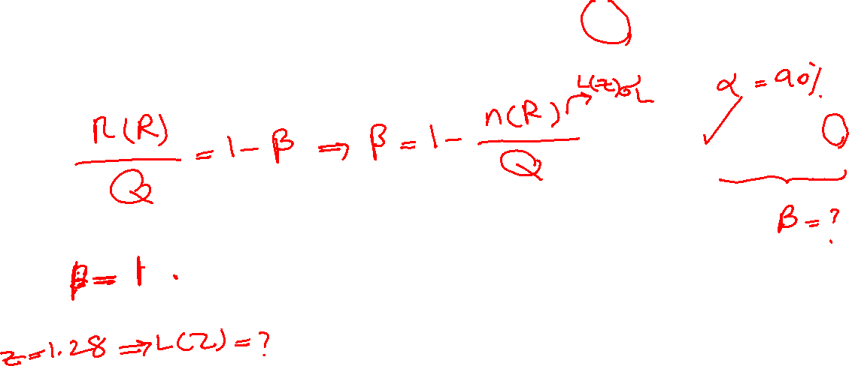
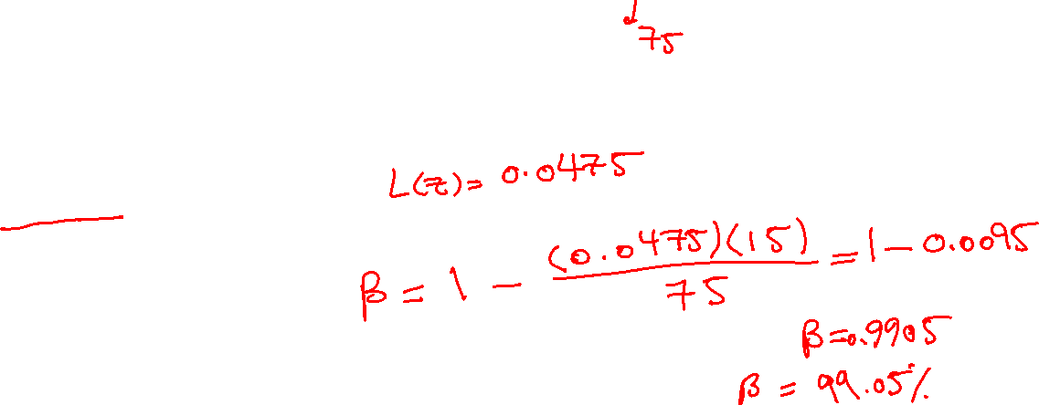
(2c) Suppose that, unfortunately, he really wanted to satisfy 90% of his demands (that is, achieve a 90% fill rate). What fill rate did he actually achieve from the policy determined in (a).
n(R)/Q = 1-β
n(R)= L(z) σ _{L}

Slide 19
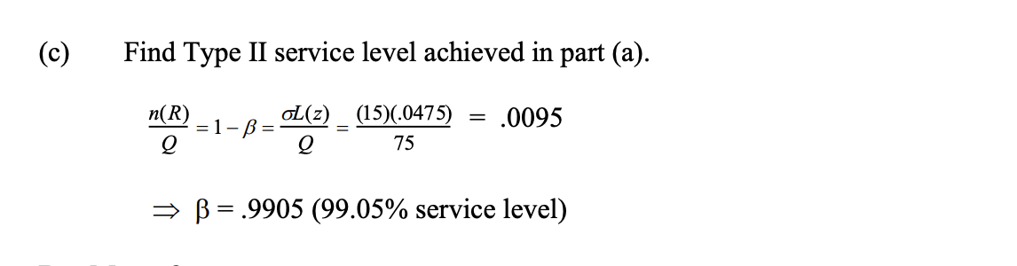
(2c) Suppose that, unfortunately, he really wanted to satisfy 90% of his demands (that is, achieve a 90% fill rate). What fill rate did he actually achieve from the policy determined in (a).
Problem & Solution

Slide 20
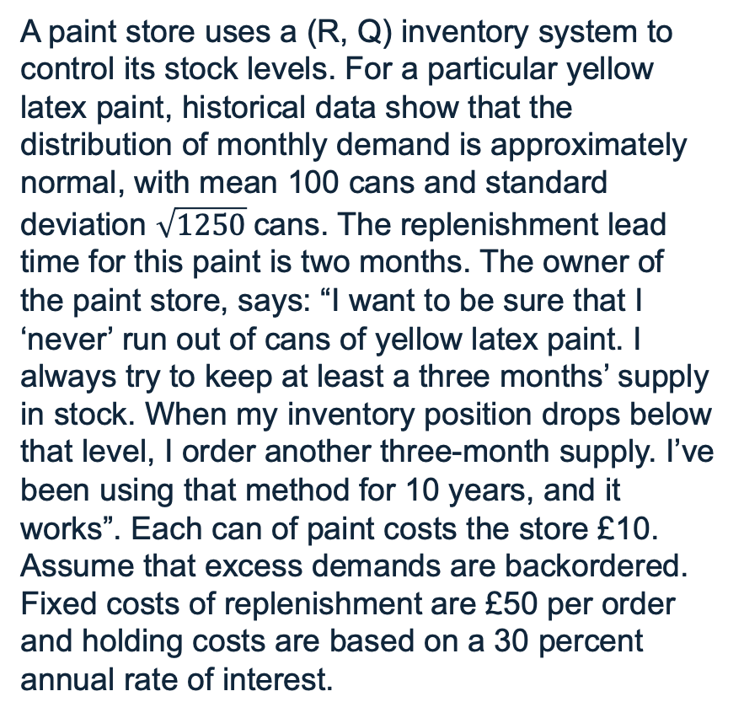
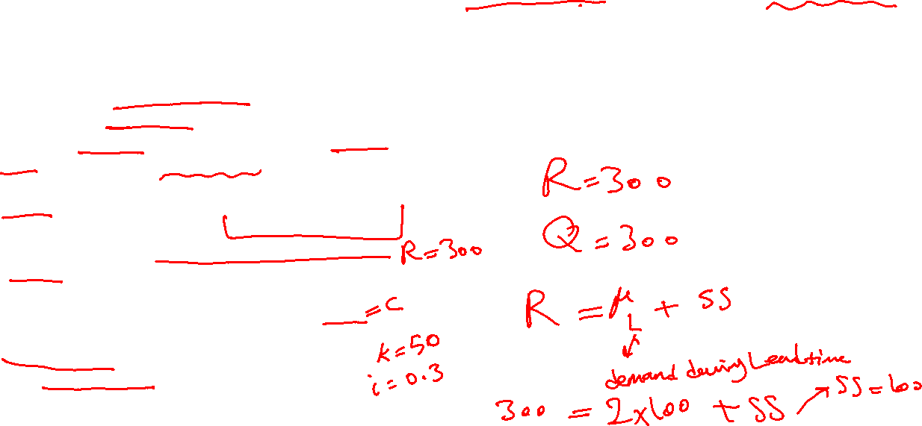
Problem 3
(3a) What value of R and Q is the shop owner currently using? How large is the safety stock?
(3b) What fill rate (type 2 service level) is achieved with the shop owner’s policy?
(3c) How would you set R and Q if the goal is to achieve a type 2 service level of 98%? (Use a managerial approach.)
A paint store uses a (R, Q) inventory system to control its stock levels. For a particular yellow latex paint, historical data show that the distribution of monthly demand is approximately normal, with mean 100 cans and standard deviation $\sqrt{1250}$cans. The replenishment lead time for this paint is two months. The owner of the paint store, says: “I want to be sure that I ‘never’ run out of cans of yellow latex paint. I always try to keep at least a three months’ supply in stock. When my inventory position drops below that level, I order another three-month supply. I’ve been using that method for 10 years, and it works”. Each can of paint costs the store £10. Assume that excess demands are backordered. Fixed costs of replenishment are £50 per order and holding costs are based on a 30 percent annual rate of interest.

Slide 21
(3a) What value of R and Q is the shop owner currently using? How large is the safety stock?
R = λτ + SS = $μ_{L}+zσ_{L}$
Problem & Solution

Slide 22
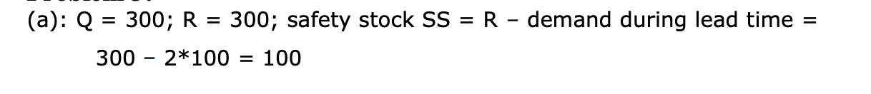
(3a) What value of R and Q is the shop owner currently using? How large is the safety stock?
Problem & Solution

Slide 23


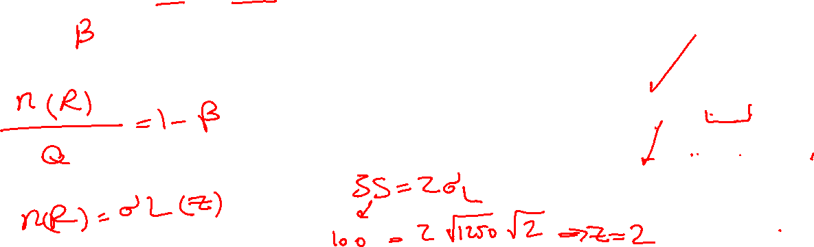

(3b) What fill rate (type 2 service level) is achieved with the shop owner’s policy?
n(R)/Q = 1-β
L(z) = n(R) / σ
R = λτ + SS = $μ_{L}+zσ_{L}$
$$z{=SS/σ}_{L}$$
σ_{L​}=σ​​$\sqrt{\text{t}}$

Slide 24
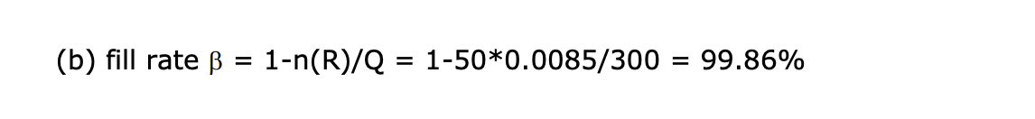
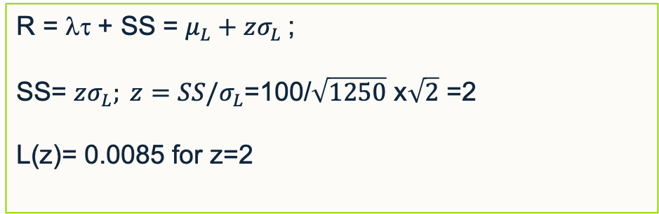
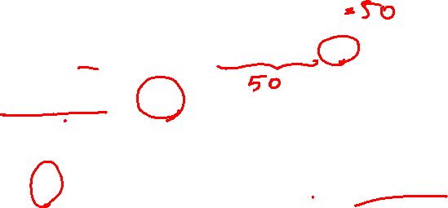

(3b) What fill rate (type 2 service level) is achieved with the shop owner’s policy?
R = λτ + SS = $μ_{L}+zσ_{L}$;
SS= $zσ_{L}; z{=SS/σ}_{L}$=100/$\sqrt{1250}$ x$\sqrt{2}$ =2
L(z)= 0.0085 for z=2
σ_{L​}=σ​​$\sqrt{\text{t}}$
L(z) σ _{L} = n(R)
Problem & Solution

Slide 25
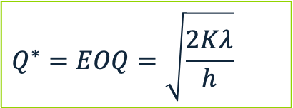

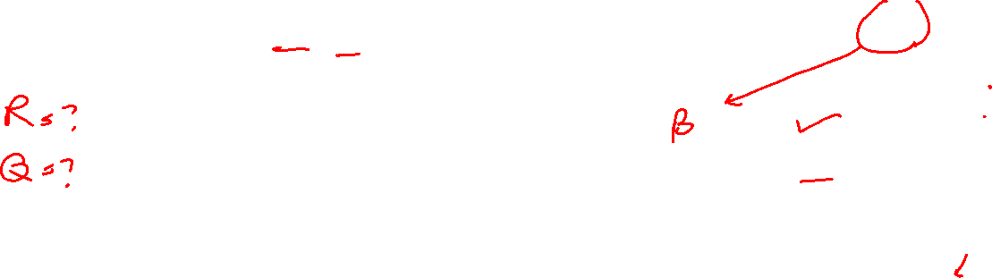
(3c) How would you set R and Q if the goal is to achieve a type 2 service level of 98%? (Use a managerial approach.)
$$Q^{∗}=EOQ=\sqrt{\frac{2Kλ}{h}}$$
R = λτ + SS = $μ_{L}+zσ_{L}$
n(R)/Q = 1-β
L(z) = n(R) / σ

Slide 26

(3c) How would you set R and Q if the goal is to achieve a type 2 service level of 98%? (Use a managerial approach.)
$$Q^{∗}=EOQ=\sqrt{\frac{2Kλ}{h}}$$
R = λτ + SS = $μ_{L}+zσ_{L}$
n(R)/Q = 1-β
L(z) = n(R) / σ

Slide 27
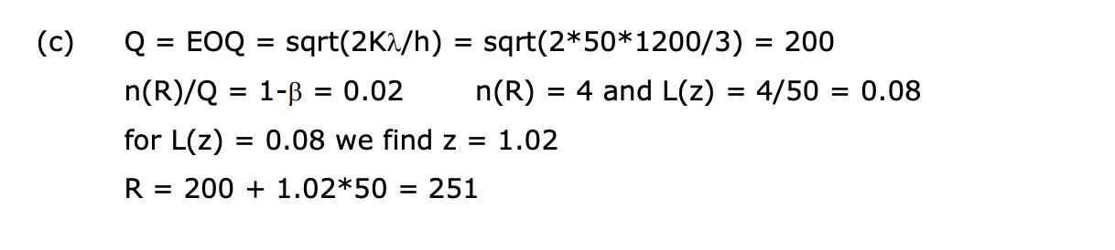
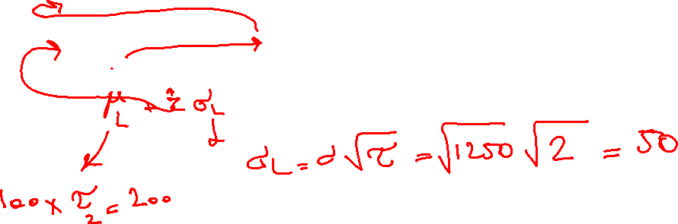
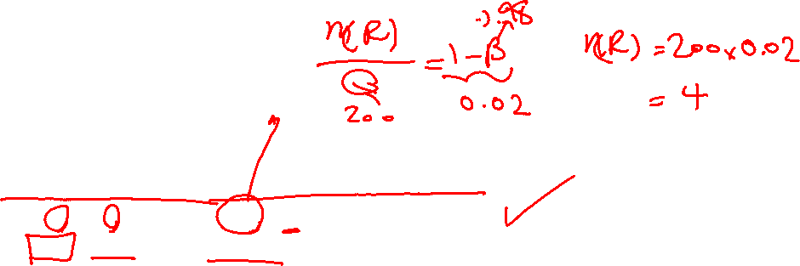
(3c) How would you set R and Q if the goal is to achieve a type 2 service level of 98%? (Use a managerial approach.)
Problem & Solution

